Slide 1
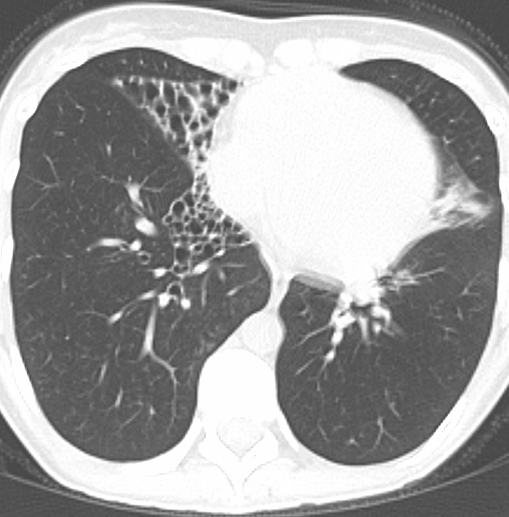
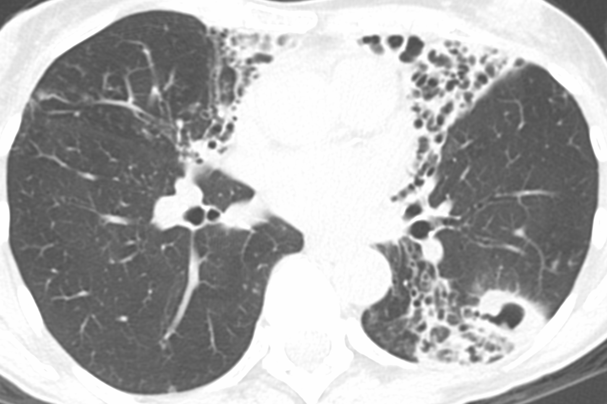
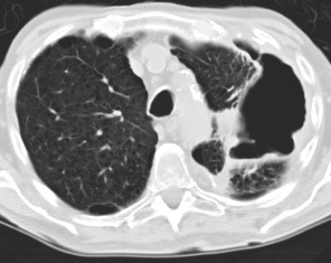
 | Nodular bronchiectasis (n=104) | Nodular bronchiectasis with cavitation (n=36) | Fibrocavitary disease (n=12) | Unclassified (n=8) | p-value
Age (mean yrs ± SD) | 66.6 ± 10.0 | 65.6 ± 7.2 | 67.7 ± 7.6 | 59.6 ± 15.3 | 0.542
Female sex [n (%)] | 97 (93.3%) | 34 (94.4%) | 10 (83.3%) | 7 (87.5%) | 0.347
Nodular bronchiectasis
Nodular bronchiectasis
with cavitation
Fibrocavitary disease
Figure 1
Bosko EJV, Lyu J et al

Slide 2
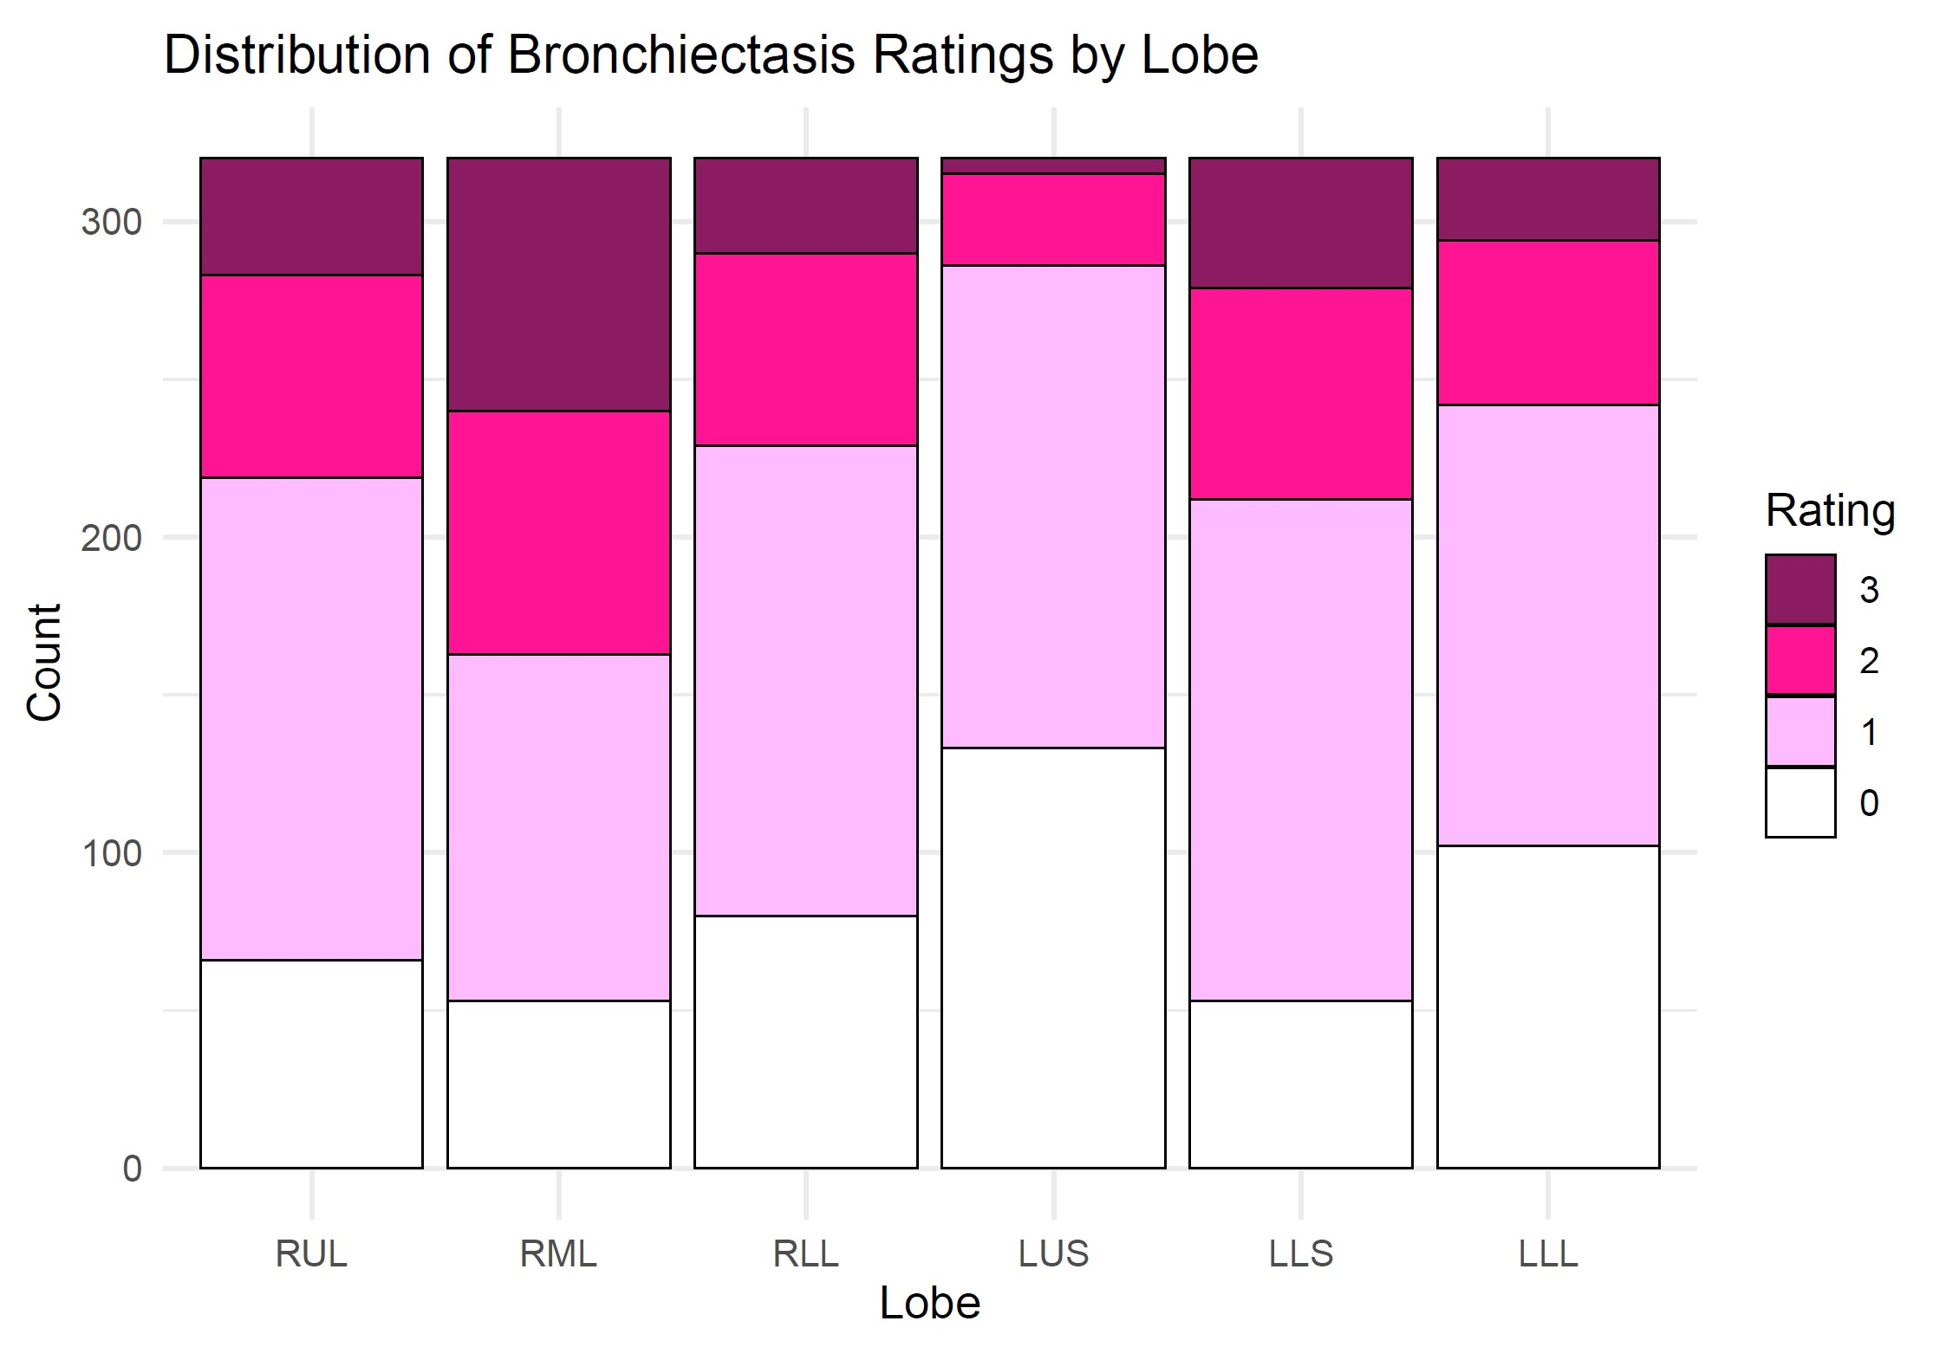
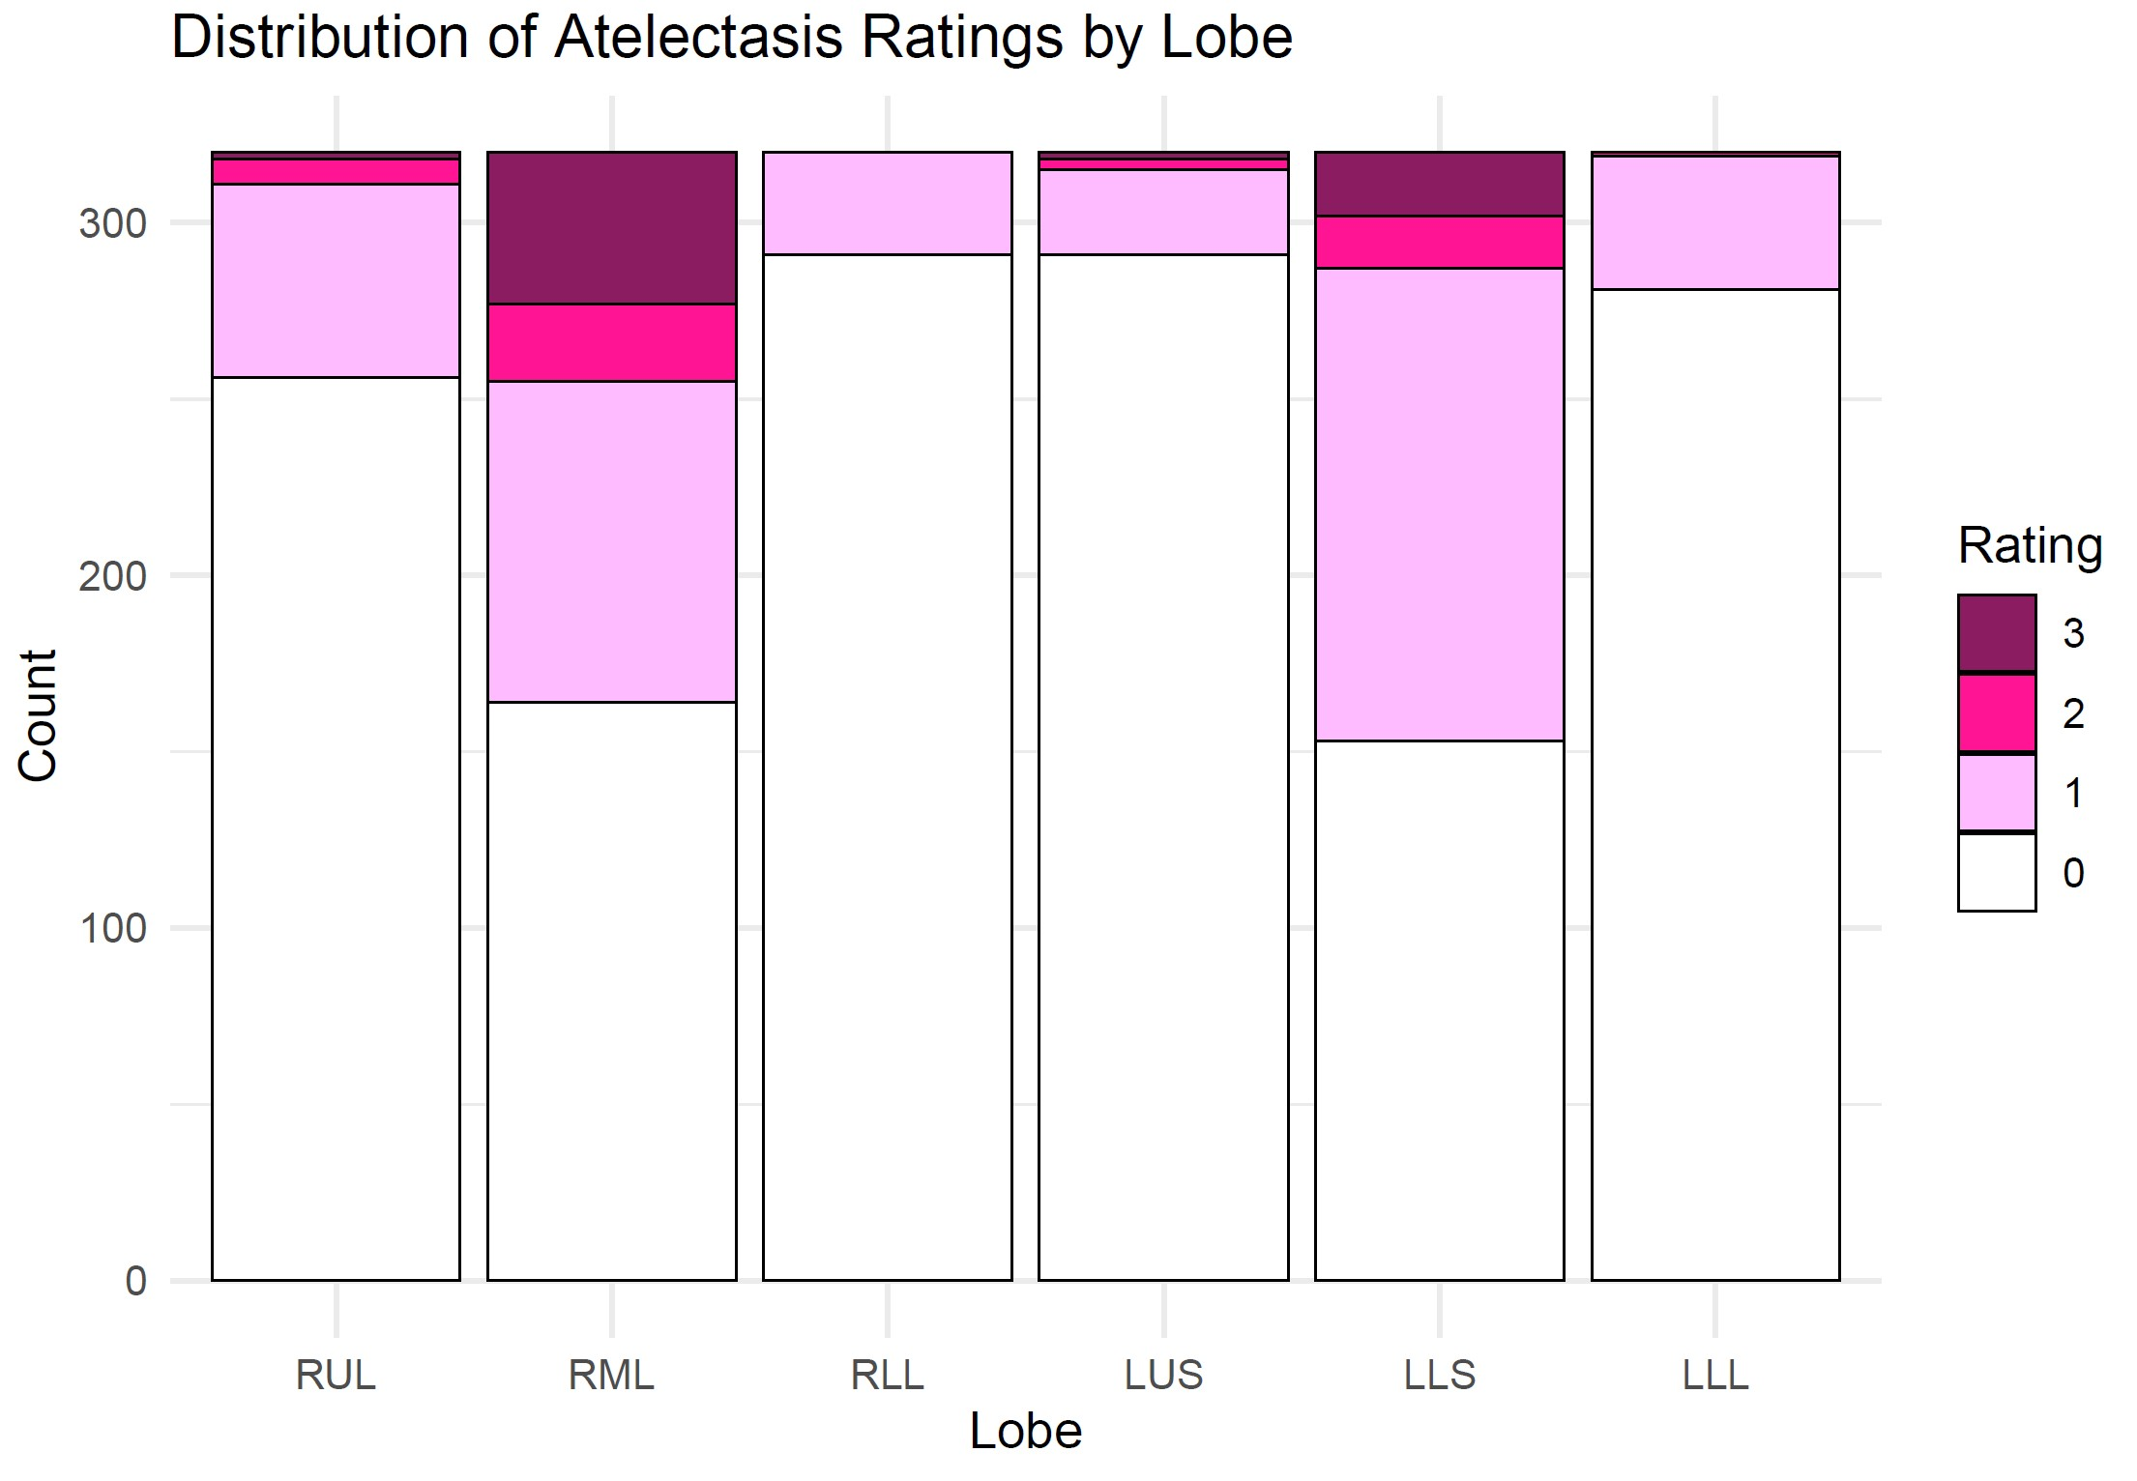
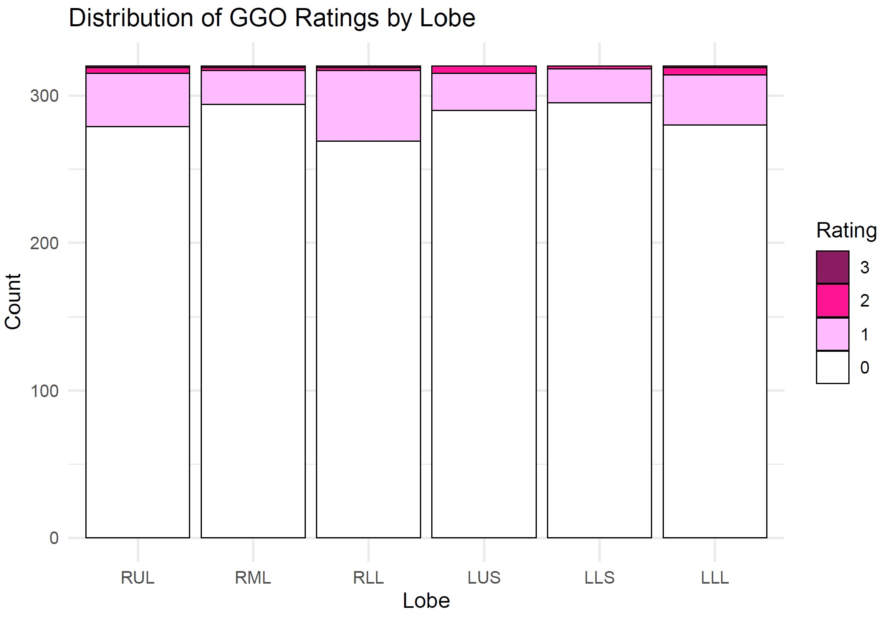

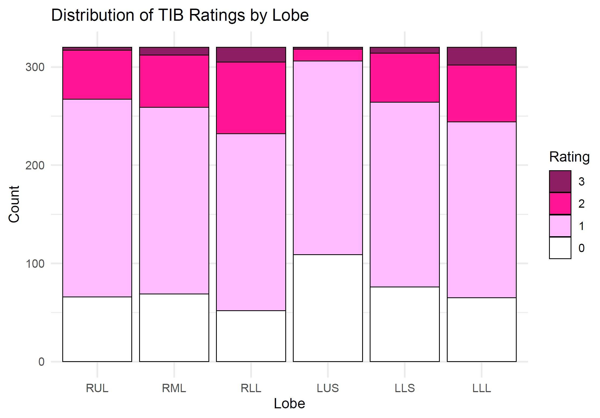
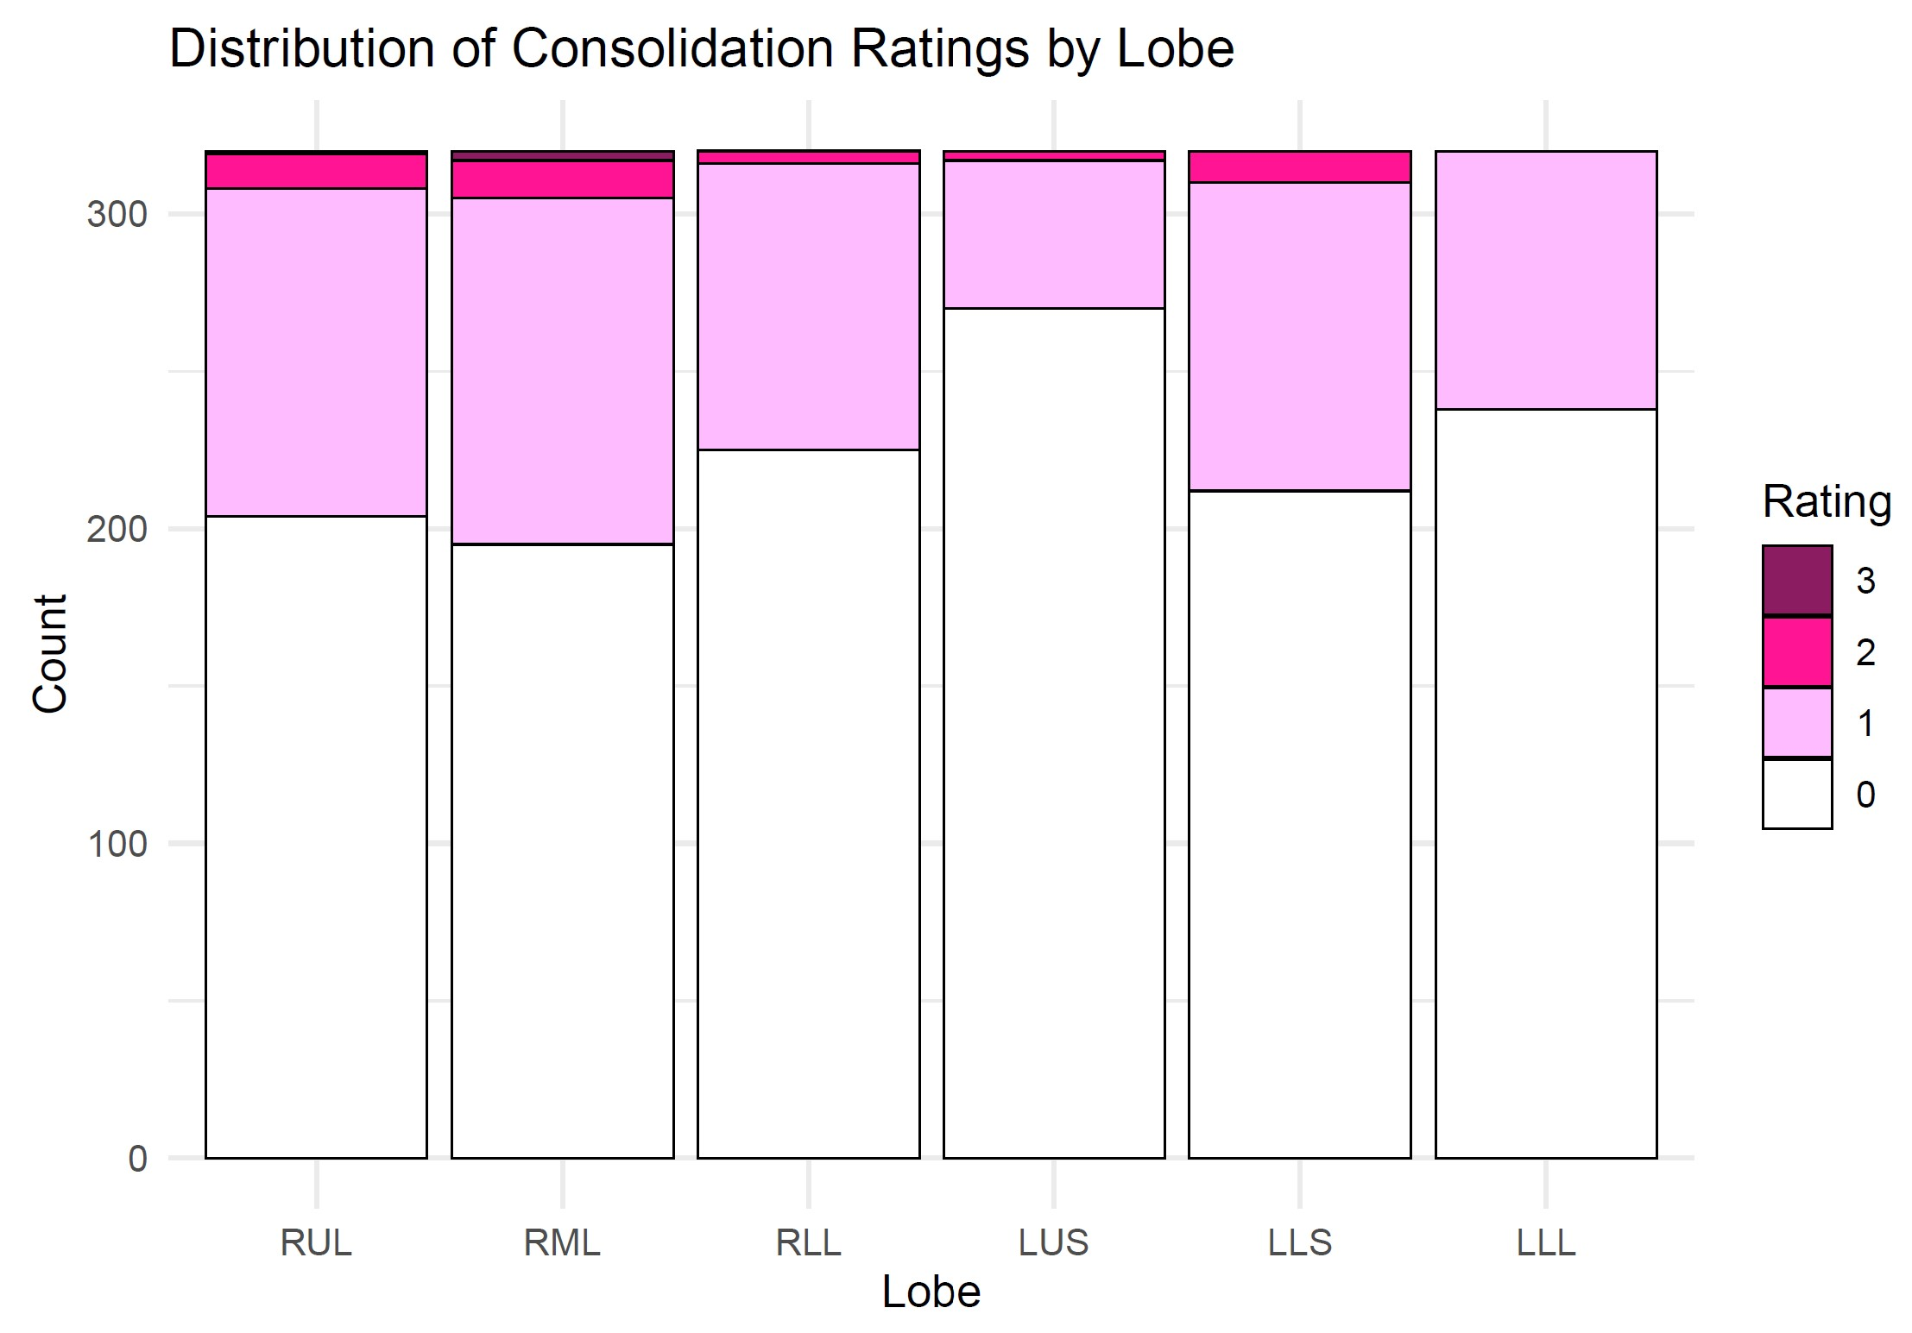
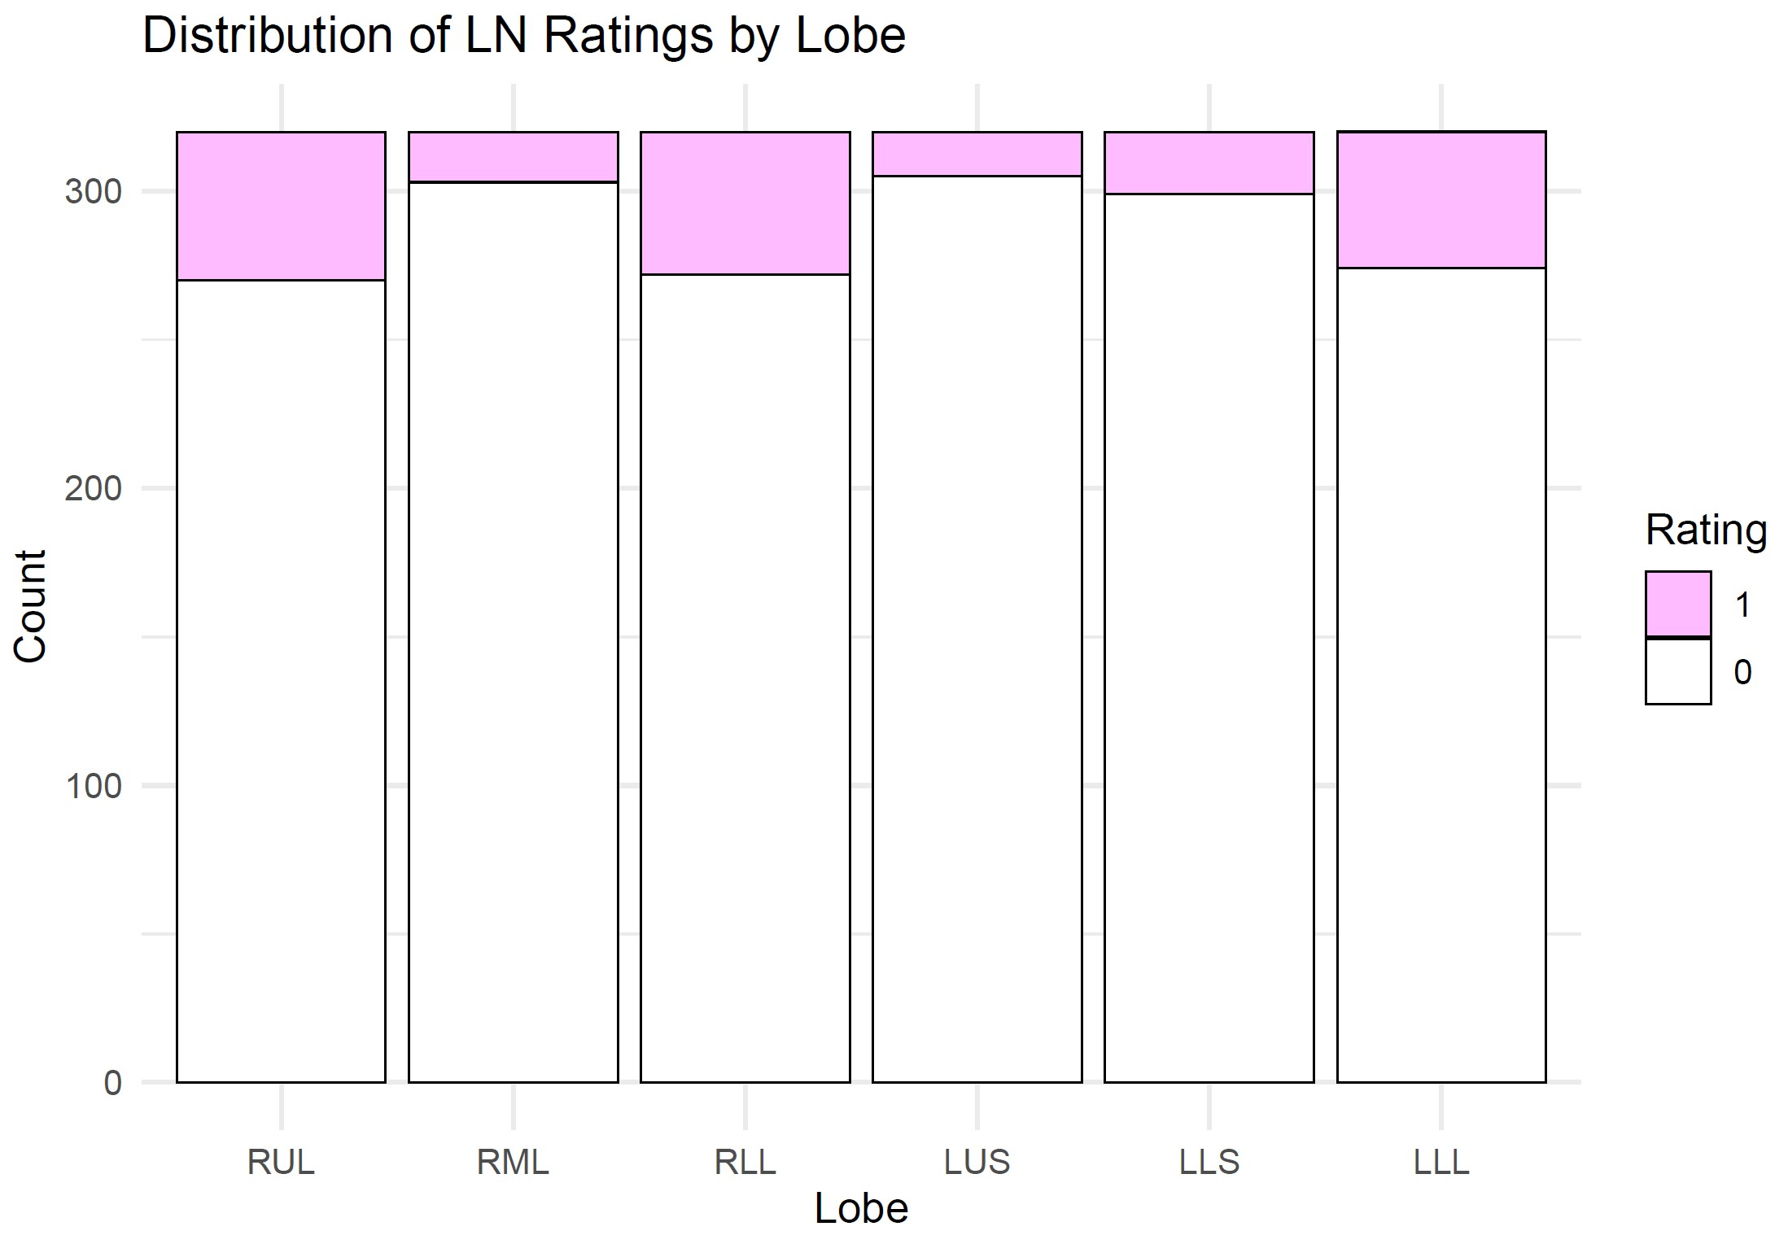
A) Bronchiectasis
D) Ground glass opacities
Counts
RUL
RML
RLL
LUS
Ling
LLL
Grades
Counts
RUL
RML
RLL
LUS
Ling
LLL
300
300
200
200
100
100
B) Atelectasis
Grades
E) Tree-in-bud opacities
300
300
200
200
100
100
C) Consolidation
Grades
F) Large nodules
300
YES
300
200
NO
200
100
100
Figure 2
Bosko EJV, Lyu J et al

Slide 3
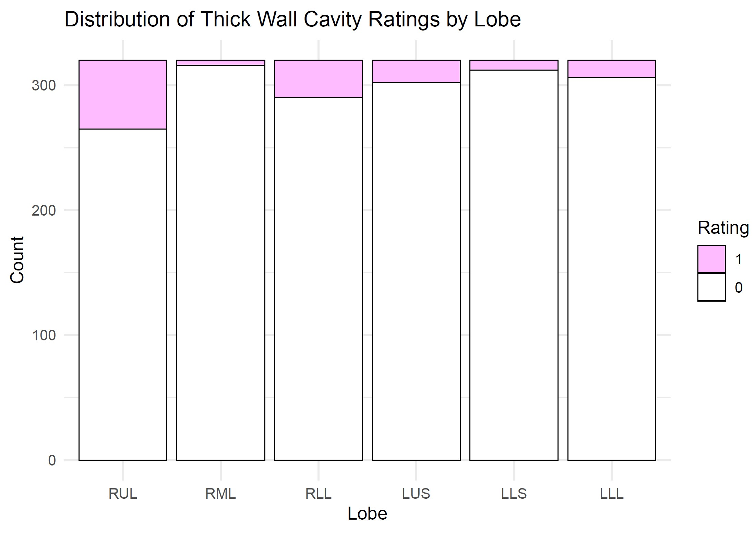
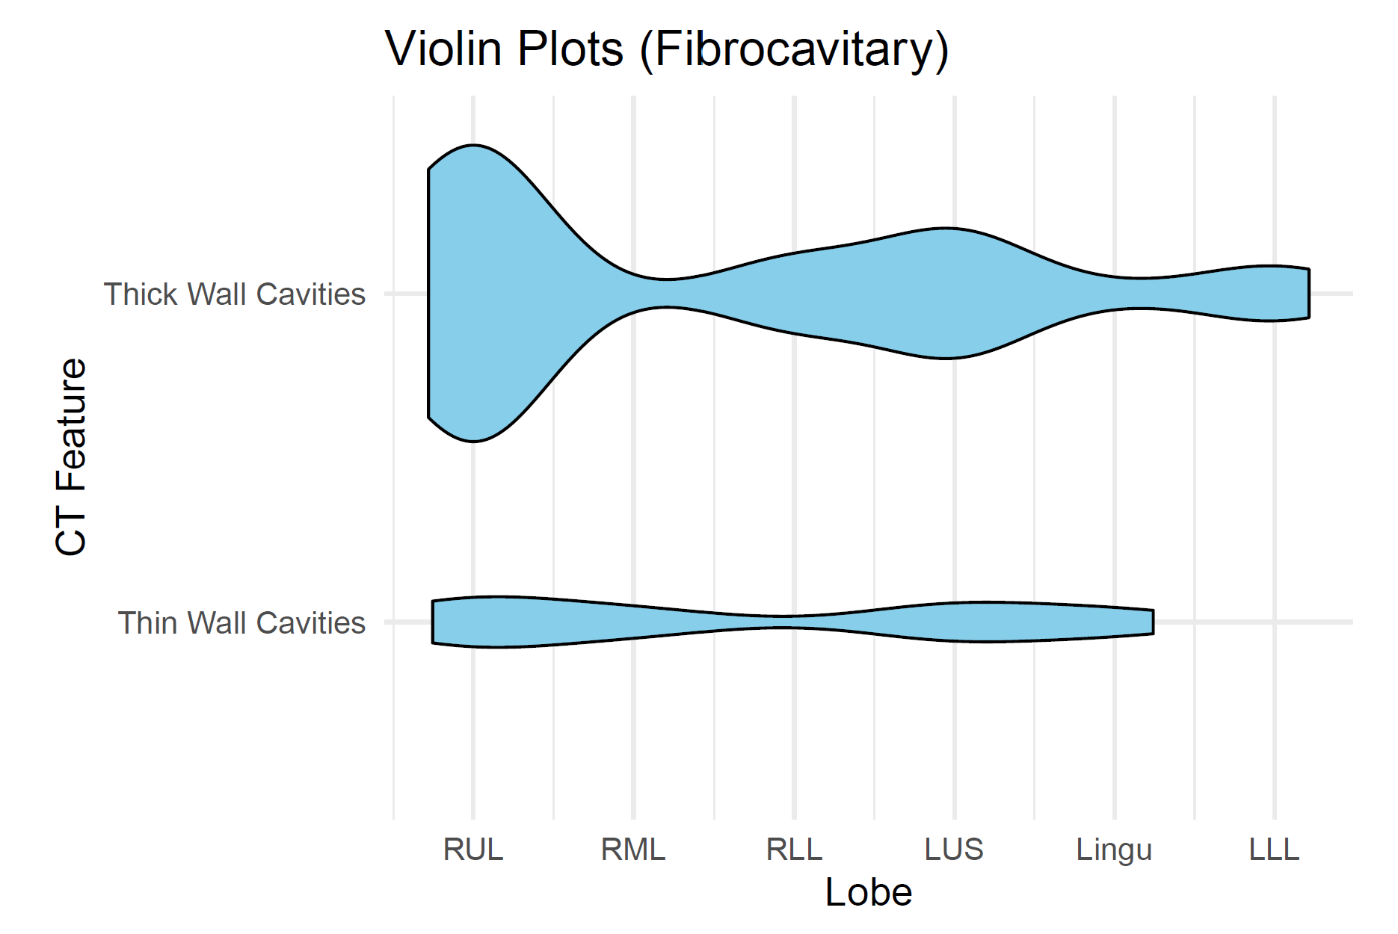
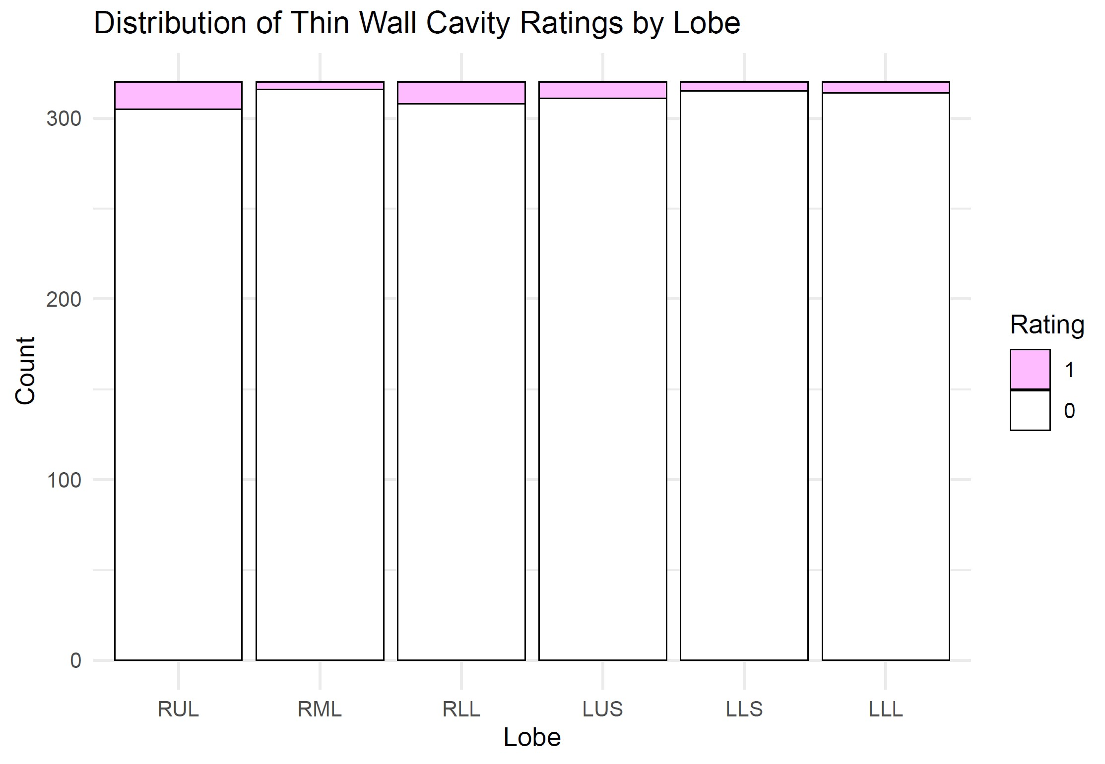
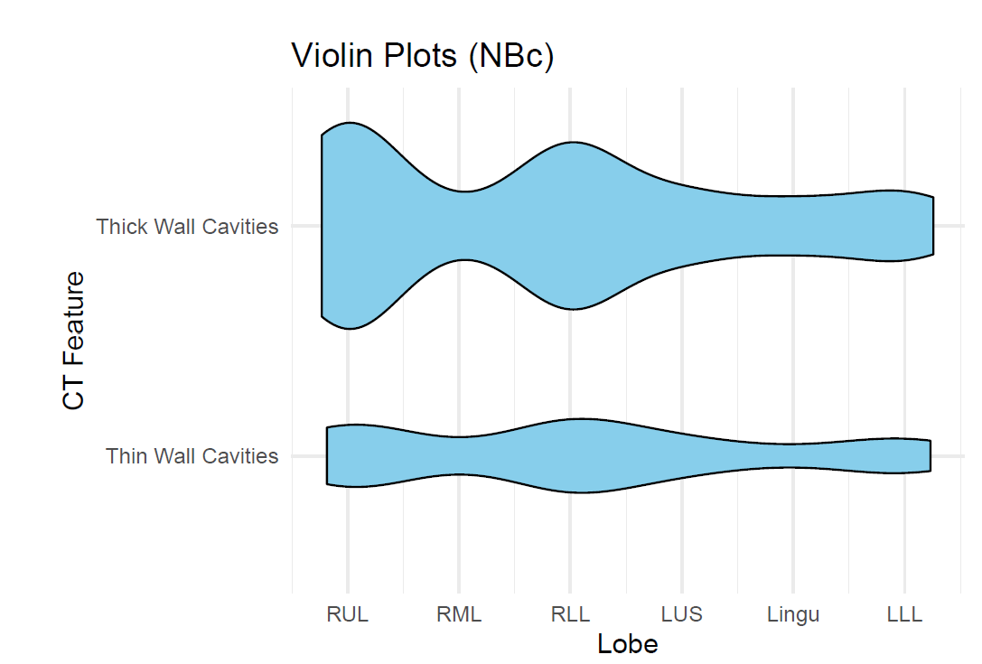
Fibrocavitary disease
Edward: please make the updated cavity data (right bar graphs) into the violin plots …please separate the data into fibrocavitary and nodular bronchiectasis categories as shown by the violin plots from the original set of data (on the left)…make the violin plot outline for the thick wall cavity really thick and maroon in color and for the violin plot outline for the thin wall cavity thinner and bright red (examples below). Make the insides of the violin plots blank.
Thick-wall
cavity
Thin-wall
cavity
RUL
RML
RLL
LUS
Lingu
LLL
Nodular BXSIS with cavity
Thick-wall
cavity
Examples
Thin-wall
cavity
Thick-wall
cavity
Thin-wall
cavity
RUL
RML
RLL
LUS
Lingu
LLL

Slide 4
Edward: please update this Table for the cavities (teal highlighted)
 | Fibrocavitary disease (n=13)
Cavity | RUL | RML | RLL | LUS | Lingu | LLL
Thick-wall | 11 85% | 0 0% | 2.5 19% | 4.5 35% | 0.5 3.9% | 2 15%
Thin-wall | 2 15% | 1 8% | 0 0% | 1.5 12% | 1 7.7% | 0 0%
Nodular BXSIS with cavity (n=36)
RUL | RML | RLL | LUS | Lingu | LLL
16 44% | 2 6% | 13 35% | 4.5 13% | 3.5 10% | 5 14%
5.5 15% | 1 3% | 6 17% | 2.5 7% | 1 3% | 3 8%
All cavities: RUL, RLL, LUS > others (OR 2.340-58.29)
Fibrocavitary disease
Nodular BXSIS with cavity
Thick-wall
cavity
Thin-wall
cavity
RUL
RML
RLL
LUS
Lingu
LLL
RUL
RML
RLL
LUS
Lingu
LLL
Figure 3
Bosko EJV, Lyu J et al

Slide 5
Why are NTM (& TB) cavities more common in the upper lobes?
Decreased blood perfusion
Decreased lymphatic formation
Increased P_{A}O₂
Increased pH
Increased stiffness & mechanical stress on lung tissue
0.07
0
0
7.51
132
200
80
1.30
24
+++
7.39
Perfusion
(L/min)
P_{PA}
(mmHg)
89
30
10
Lymph
flow
pH
P_{A}O₂
(mmHg)
Stiffness (kPa)
Stress (kPa)
Decreased influx of immune cells, soluble mediators, & antibiotics
Decreased clearance
of NTM & antigens
Increased Warburg → decreased of both autophagy & killing of NTM
Increased aerobic growth of NTM
Increased risk of cavitation
Figure 4
Bosko EJV, Lyu J et al
Casha AR et al. J Infect Dis Epidemiol 2018
Shi L…Suki B. Scientific Rep 2022

Slide 6
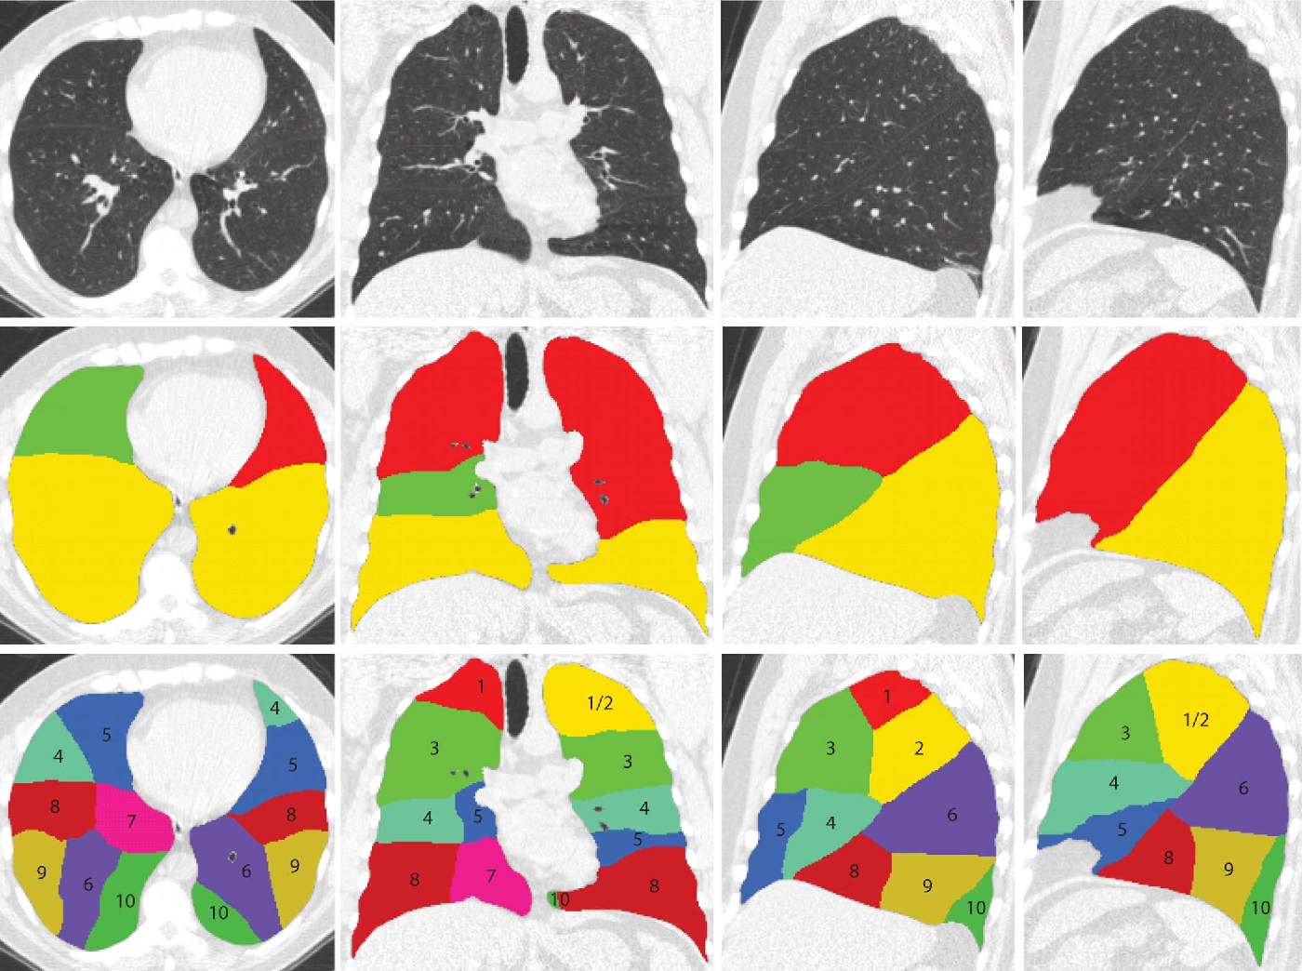
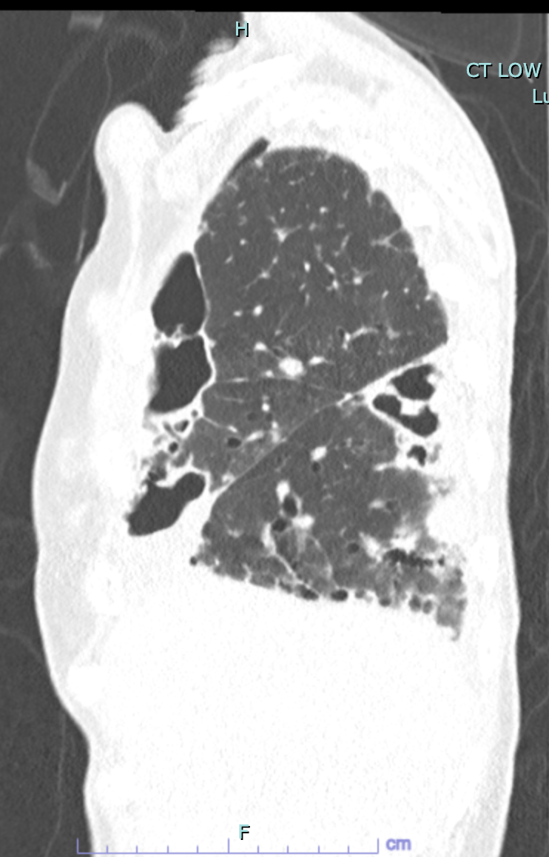
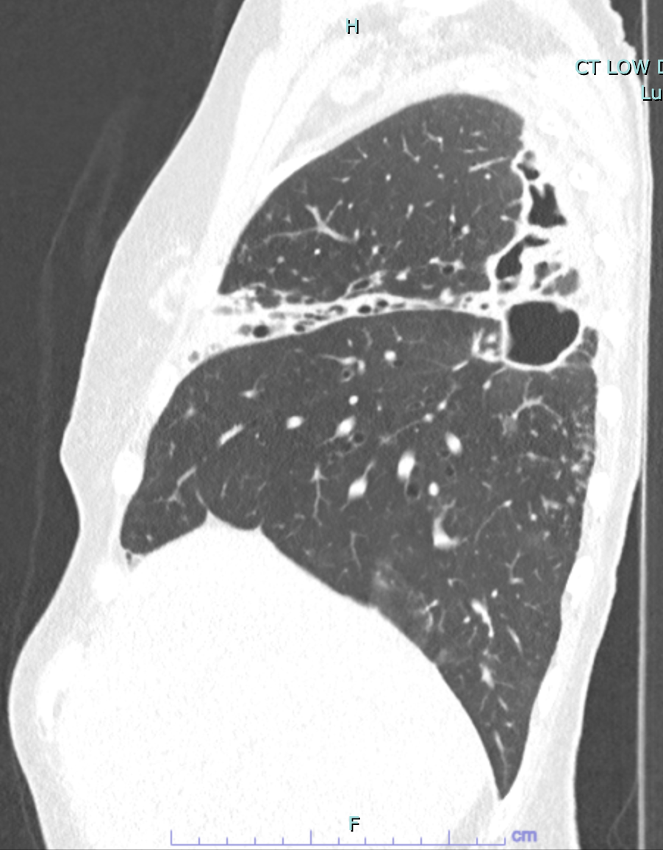
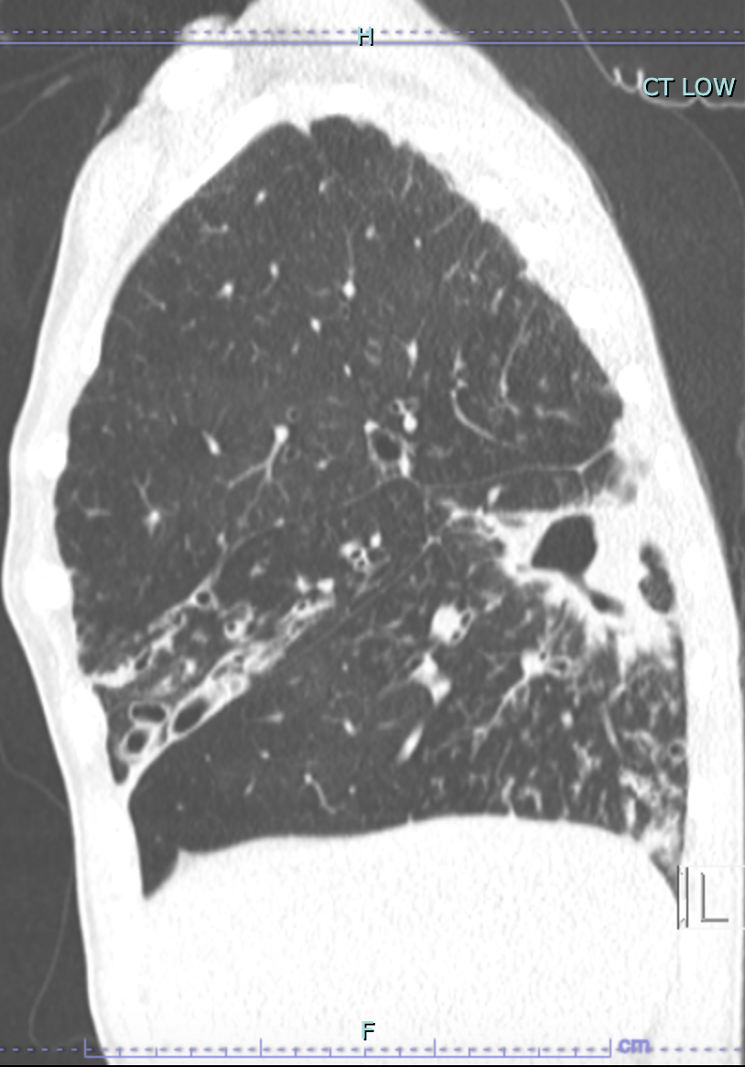
Patient #, CT Date | Cavity location in RLL
Patient 1, 8.15.2023 | Superior segment (SS)
Patient 2, 1.10.2023 | SS
Patient 3, 8.30.2023 | SS
Patient 4, 8.1.2023 | SS
Patient 5, 5.9.2023 | SS
Patient 6, 12.6.2023 | SS
Patient 7, 1.22.2024 | SS
Patient 8, 5.24.2023 | SS
Patient 9, 5.31.2023 | SS
Patient 10, 6.1.2023 | SS
Patient 11, 6.8.2023 | SS
Patient 12, 8.11.2023 | R posterior basal?
Patient 13, 6.15.2023 | R posterior basal?
Patient 14, 6.27.2018 | SS
Patient 15, 5.29.2024 | SS
Patient 16, 11.9.2017 | SS
Patient 17, 2.20.2024 | R posterior basal?
Patient 18, 4.7.2023 | SS
Patient 19, 3.24.2023 | SS
Patient 4
August 1, 2023
Patient 7
Jan 22, 2024
Patient 8
May 24, 2023

